Slide 1


biblia kwa ujumla
A Presentation of The Bible…Basically Ministries International Inc. Fort Worth, Texas
BibleBasically.org
Designed by Dr. John Fryman, Texas, USA • BibleBasically.org
Taught by Dr. Rick Griffith, Singapore Bible College
All files in many languages for free download at BibleStudyDownloads.org
8.0.01.
©2003 TBBMI
04

Slide 2


(Kwani ni wapi hapa?)
Bibilia kwa…..ujumla
®
Sehemu ya pili
Kutayarisha jukwaa
02
©2003 TBBMI
7.5.02.

Slide 3
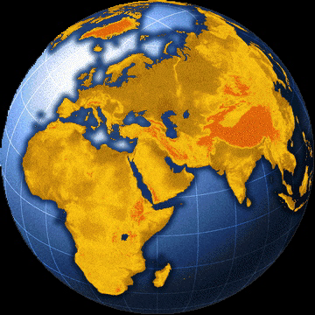
KUANDAA
JUKWAA
?
Mediterenia, jukwa la igizo la Bibilia
03
4

Slide 4
KUANDAA
JUKWAA
Bahari la Mediterrenia
LEBANONI
SHAMU
Haifa
Bahari la Galilaya
IRAKI
Nazareti
Netanya
Tel Aviv-Jaffa
AMMAN
YERUSALEMU
Yeriko
Gaza
Hebronj
Bahari la chumvi
Beer-sheba
ISRAELI
YORDANI
MISIRI
SAUDI ARABIA
Eilat
Guba la aquqbq
Al’ Aqaba
04
1

Slide 5
KUANDAA
JUKWAA
BM
N(A)
H
BG
C
MH
B
Y
MN
BC
M
KB
U
Umuhimu wa kufahamu Ramali
MS
GU
BS
Handbook pg. 15-16
05
1

Slide 6
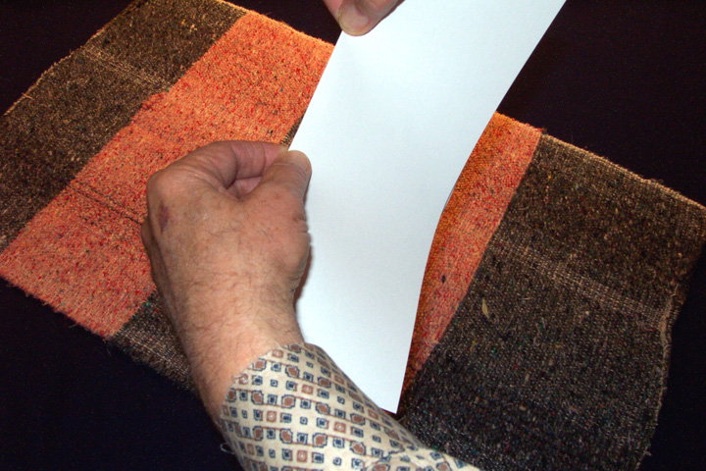
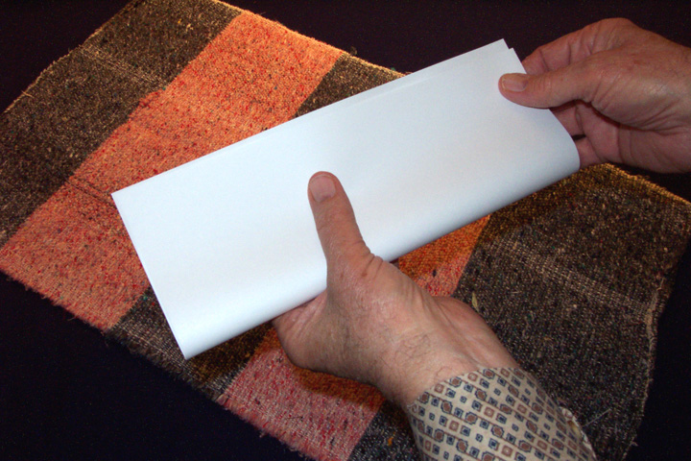
KUANDAA
JUKWAA
KWENYE KITABU #03a; (Kurasa isiyo pigwa chapa #03b)
Shika karatasi
Kwa mapana
Handbook pg. 15-16
06

Slide 7
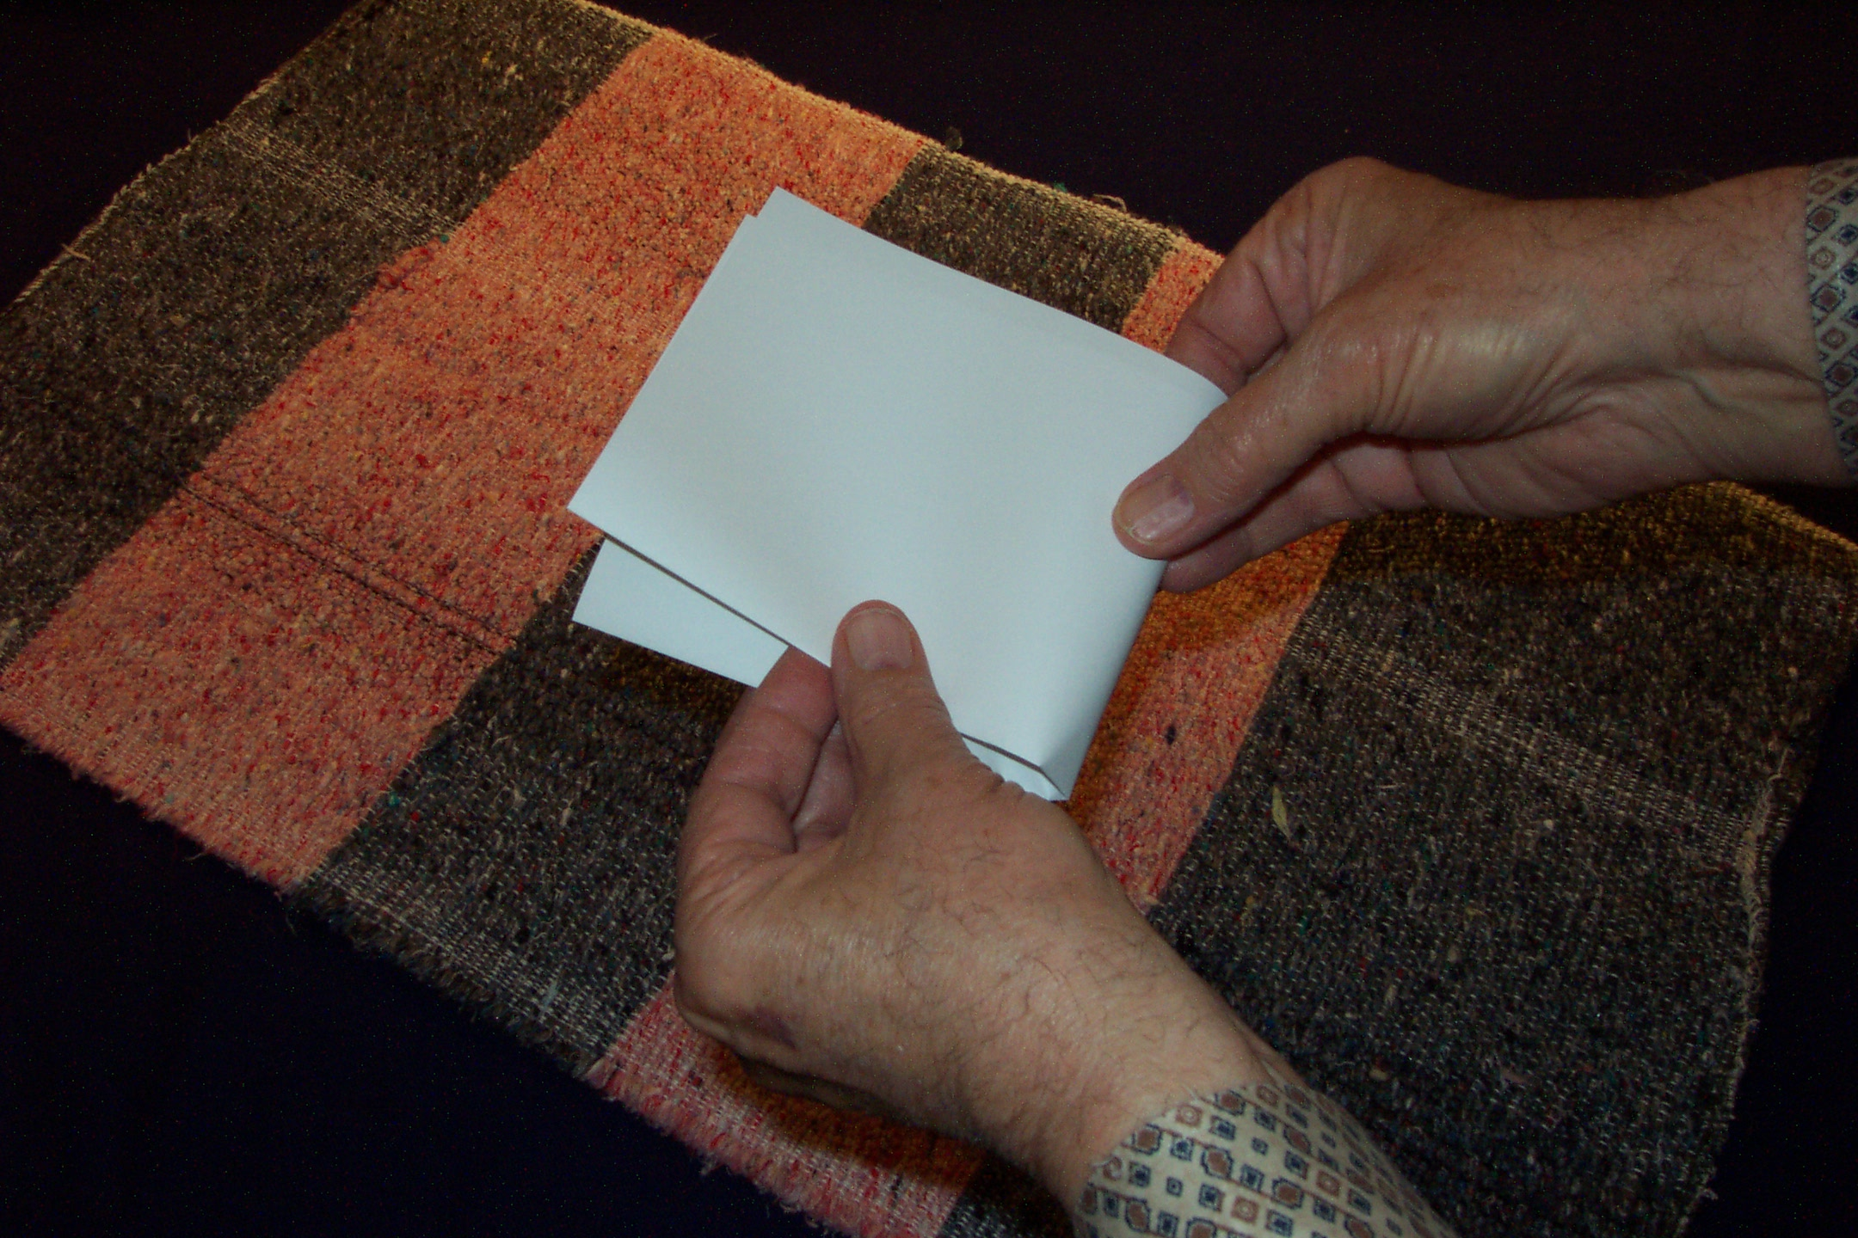
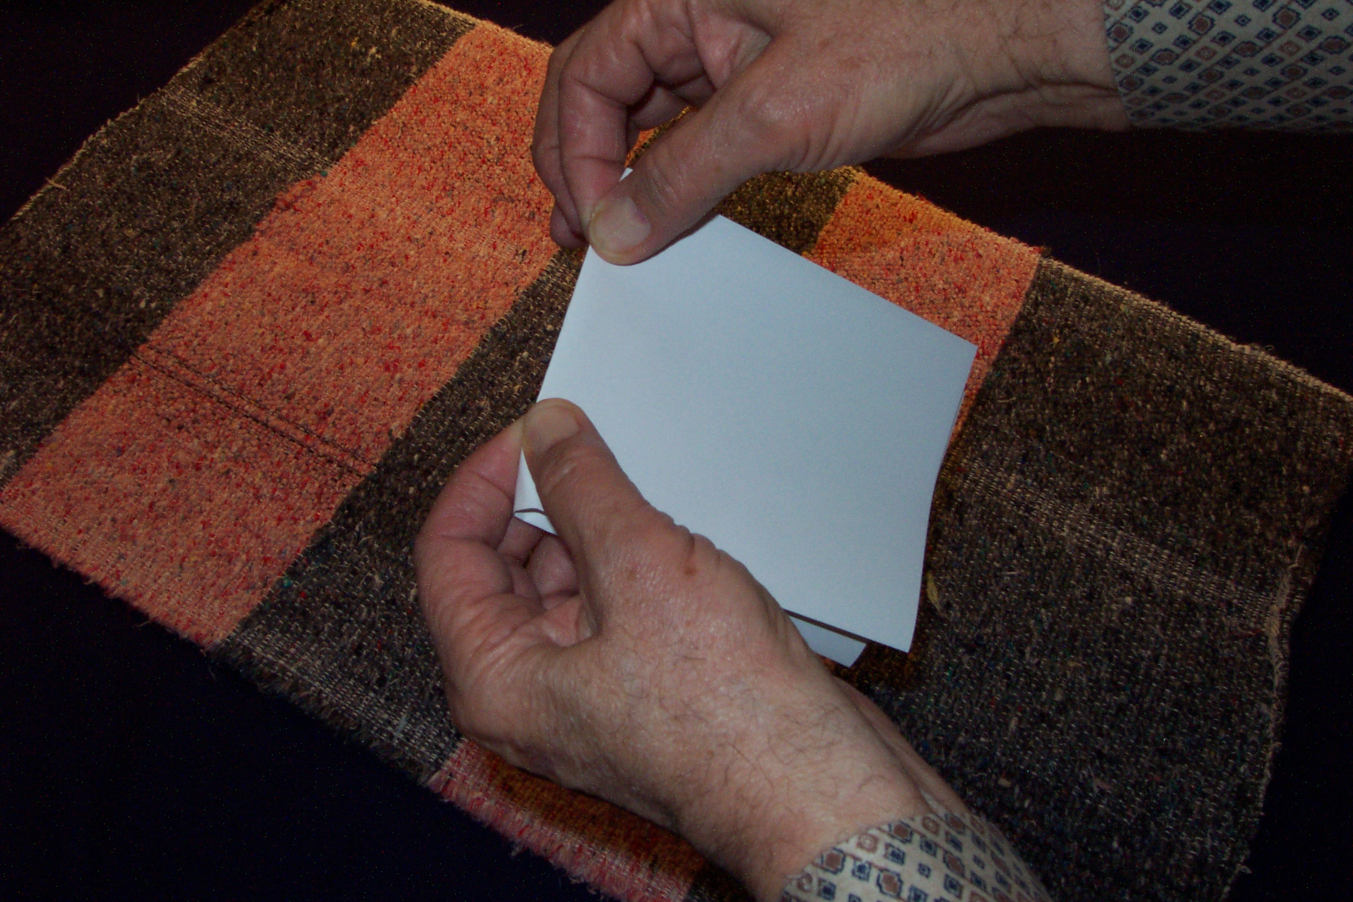
KUANDAA
JUKWAA
KUNJA MARA MBILI
ILI UPATE MISTARI MIWILI
Handbook pg. 15-16
07

Slide 8
KUANDAA
JUKWAA
DRESSING
THE
STAGE
Handbook pg. 15-16
08
3

Slide 9
KUANDAA
JUKWAA
Kwanza maeneo ya maji 6
Pili: SEHEMU ZA ARDHI 10
Tatu: MAKISIO YA MASAFA
Handbook pg. 15-16
09
2

Slide 10
KUANDAA
JUKWAA
Handbook pg. 15-16
10
1

Slide 11
KUANDAA
JUKWAA
DRESSING
THE
STAGE
Handbook pg. 15-16
11

Slide 12
KUANDAA
JUKWAA
USITUMIE MAJINA,
BALI HERUFI YA KWANZA
YA KILA JINA
SIO JINA NZIMA
Handbook pg. 15-16
12

Slide 13
KUANDAA
JUKWAA
B M
Handbook pg. 15-16
13

Slide 14
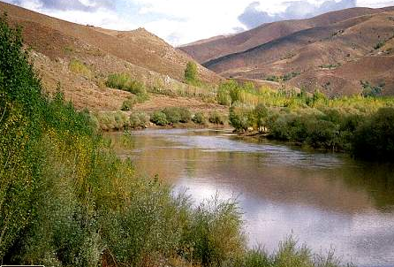
KUANDAA
JUKWAA
DRESSING
THE
STAGE
BM
MH
Handbook pg. 15-16
14

Slide 15

KUANDAA
JUKWAA
DRESSING
THE
STAGE
BM
MH
GU
Handbook pg. 15-16
15

Slide 16
KUANDAA
JUKWAA
DRESSING
THE
STAGE
BM
(BAHARI LA MEDITERENIA)
MH
(MTO WA HIDEKELI
GU
(GUBA LA UAJEMI
Handbook pg. 15-16
16
2

Slide 17
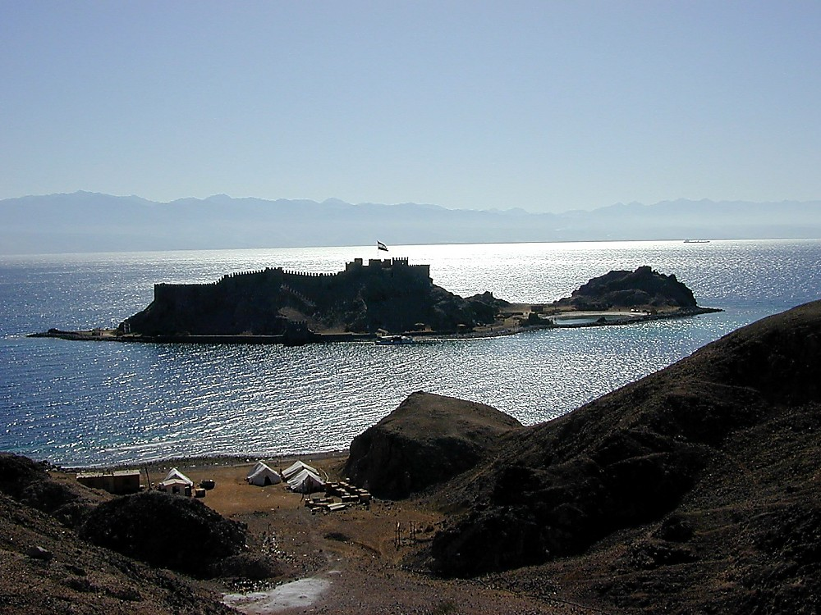

KUANDAA
JUKWAA
DRESSING
THE
STAGE
BM
ER
GU
Handbook pg. 15-16
17

Slide 18
KUANDAA
JUKWAA
DRESSING
THE
STAGE
BM
ER
GU
BS
Handbook pg. 15-16
18

Slide 19
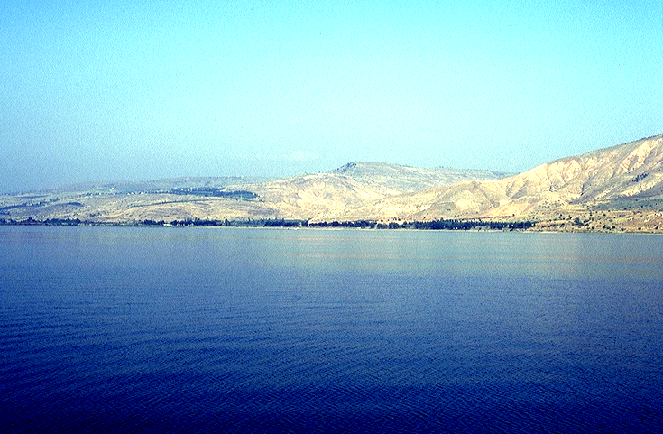
KUANDAA
JUKWAA
DRESSING
THE
STAGE
BM
ER
GU
BS
Handbook pg. 15-16
19

Slide 20
KUANDAA
JUKWAA
DRESSING
THE
STAGE
BM
MH
GU
BS
Handbook pg. 15-16
20

Slide 21
KUANDAA
JUKWAA
DRESSING
THE
STAGE
BM
BG
ER
GU
BS
Handbook pg. 15-16
21

Slide 22
KUANDAA
JUKWAA
DRESSING
THE
STAGE
BM
BG
MH
BC
GU
BS
Handbook pg. 15-16
22

Slide 23
KUANDAA
JUKWAA
DRESSING
THE
STAGE
BM
BG
ER
BC
MTO WA YORDANI
GU
BS
Handbook pg. 15-16
23

Slide 24
KUANDAA
JUKWAA
BM
MAENEO YA MAJI
6
BG
MH
BC
GU
BS
Handbook pg. 15-16
24
7

Slide 25

KUANDAA
JUKWAA
MS
SG
ER
“THE LAND”
DS
PG
RS
Handbook pg. 15-16
25
1

Slide 26
KUANDAA
JUKWAA
SEHEMU 10
BM
Sehemu
10
BG
MH
BC
Za
GU
Ardhi
BS
Handbook pg. 15-16
26
1

Slide 27
KUANDAA
JUKWAA
Sehemu 10
MS
4
BG
MH
BC
GU
BS
Handbook pg. 15-16
27

Slide 28
KUANDAA
JUKWAA
Sehemu 10
BM
6
4
BG
MH
BC
GU
BS
Handbook pg. 15-16
28

Slide 29
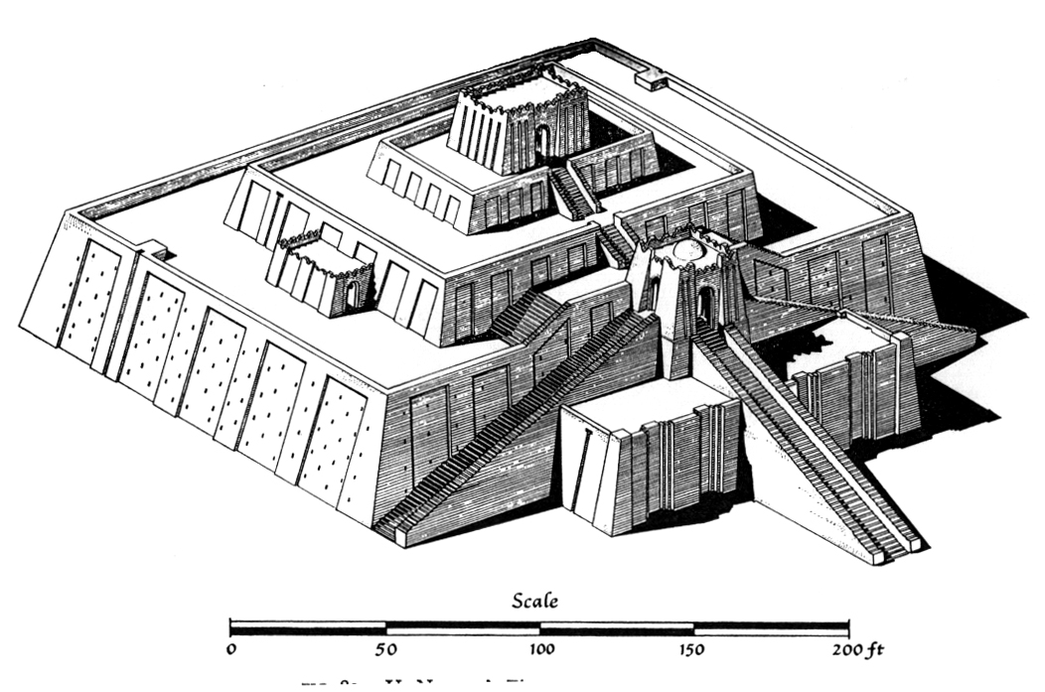
KUANDAA
JUKWAA
Sehemu 10
BM
6
4
BG
MH
DS
U
GU
RS
Handbook pg. 15-16
29

Slide 30

KUANDAA
JUKWAA
Sehemu 10
BM
6
4
BG
MH
B
DS
U
PG
RS
Handbook pg. 15-16
30

Slide 31

KUANDAA
JUKWAA
Sehemu 10
BM
6
4
H
BG
MH
B
DS
U
GU
RS
Handbook pg. 15-16
31

Slide 32
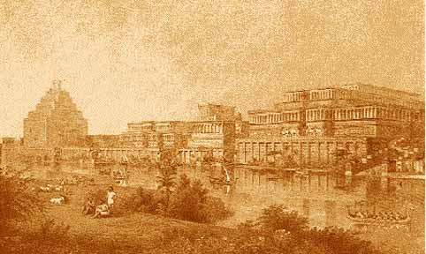
KUANDAA
JUKWAA
Sehemu 10
MS
6
4
N(A)
H
BG
MH
B
DS
U
GU
RS
Handbook pg. 15-16
32

Slide 33
KUANDAA
JUKWAA
DRESSING
THE
STAGE
SEHEMU 10
MS
6
4
N(A)
H
BG
MH
B
BC
U
PG
BS
Handbook pg. 15-16
33

Slide 34
KUANDAA
JUKWAA
DRESSING
THE
STAGE
SEHEMU 10
MS
6
4
N(A)
H
K
BG
ER
B
BC
U
PG
BS
Handbook pg. 15-16
34
1

Slide 35
KUANDAA
JUKWAA
DRESSING
THE
STAGE
SEHEMU 10
MS
4
6
N(A)
H
BG
K
ER
Y
B
BC
U
PG
BS
Handbook pg. 15-16
35

Slide 36
KUANDAA
JUKWAA
DRESSING
THE
STAGE
SEHEMU 10
MS
6
4
N(A)
H
BG
K
MH
MN
B
Y
BC
U
PG
BS
Handbook pg. 15-16
36

Slide 37
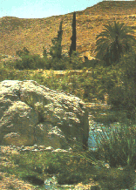
KUANDAA
JUKWAA
SEHEMU 10
MS
6
4
N(A)
H
BG
K
ER
B
Y
MN
BC
KB
U
PG
BS
Handbook pg. 15-16
37

Slide 38
KUANDAA
JUKWAA
SEHEMU 10
BM
6
4
N(A)
H
BG
K
ER
B
Y
MN
BC
M
KB
U
PG
BS
Handbook pg. 15-16
38

Slide 39
KUANDAA
JUKWAA
SEHEMU 10
BM
6
4
N(A)
H
BG
K
ER
B
Y
MN
BC
M
KB
U
MS
PG
BS
Handbook pg. 15-16
39

Slide 40
KUANDAA
JUKWAA
SEHEMU 10
BM
6
4
SEHEMU 10
ARTHI
N(A)
H
BG
K
MH
B
Y
MN
BC
M
ZA
KB
U
MS
GU
BS
Handbook pg. 15-16
40
2

Slide 41
KUANDAA
JUKWAA
SEHEMU 10
BM
6
4
N(A)
H
NCHI
SG
K
MH
B
Y
MN
DS
”KUTOKA
DANI HADI
BETHSEBA
M
KB
U
MS
GU
WAMUZI
201
BS
Handbook pg. 15-16
41
4

Slide 42
KUANDAA
JUKWAA
BM
N(A)
H
BG
K
MH
B
Y
MN
BC
“JUKWAA LA
IGIZO!”
M
KB
U
MS
GU
BS
Handbook pg. 15-16
42

Slide 43
KUANDAA
JUKWAA
DRESSING
THE
STAGE
HEBU TUFANYE
MARUDIO
Handbook pg. 15-16
43

Slide 44
KUANDAA
JUKWAA
DRESSING
THE
STAGE
Handbook pg. 15-16
44

Slide 45
KUANDAA
JUKWAA
DRESSING
THE
STAGE
Handbook pg. 15-16
45

Slide 46
KUANDAA
JUKWAA
DRESSING
THE
STAGE
Handbook pg. 15-16
46

Slide 47
KUANDAA
JUKWAA
DRESSING
THE
STAGE
Handbook pg. 15-16
47

Slide 48
KUANDAA
JUKWAA
DRESSING
THE
STAGE
BM
Handbook pg. 15-16
48

Slide 49
KUANDAA
JUKWAA
DRESSING
THE
STAGE
MS
MH
Handbook pg. 15-16
49

Slide 50
KUANDAA
JUKWAA
DRESSING
THE
STAGE
BM
MH
GU
Handbook pg. 15-16
50

Slide 51
KUANDAA
JUKWAA
DRESSING
THE
STAGE
BM
BAHARI LA MEDITERENIA
MH
(MTO WA HIDEKELI
GU
(GUBA LA UAJEMI)
Handbook pg. 15-16
51

Slide 52
KUANDAA
JUKWAA
DRESSING
THE
STAGE
BM
MH
GU
Handbook pg. 15-16
52

Slide 53
KUANDAA
JUKWAA
DRESSING
THE
STAGE
BM
MH
GU
BS
Handbook pg. 15-16
53

Slide 54
KUANDAA
JUKWAA
DRESSING
THE
STAGE
BM
MH
GU
BS
Handbook pg. 15-16
54

Slide 55
KUANDAA
JUKWAA
DRESSING
THE
STAGE
BM
MH
GU
BS
Handbook pg. 15-16
55

Slide 56
KUANDAA
JUKWAA
DRESSING
THE
STAGE
BM
MH
GU
BS
Handbook pg. 15-16
56

Slide 57
KUANDAA
JUKWAA
DRESSING
THE
STAGE
BM
BG
MH
GU
BS
Handbook pg. 15-16
57

Slide 58
KUANDAA
JUKWAA
DRESSING
THE
STAGE
BM
BG
MH
BC
GU
BS
Handbook pg. 15-16
58

Slide 59
KUANDAA
JUKWAA
DRESSING
THE
STAGE
BM
BG
MH
MTO WA YORDANI
BC
GU
BS
Handbook pg. 15-16
59
1

Slide 60
KUANDAA
JUKWAA
DRESSING
THE
STAGE
SEHEMU 10 ZA ARDHI
MS
BG
MH
BC
GU
BS
Handbook pg. 15-16
60

Slide 61
KUANDAA
JUKWAA
DRESSING
THE
STAGE
SEHEMU 10
MS
4
BG
MH
BC
GU
BS
Handbook pg. 15-16
61

Slide 62
KUANDAA
JUKWAA
SEHEMU 10
BM
6
4
BG
MH
BC
GU
BS
Handbook pg. 15-16
62

Slide 63
KUANDAA
JUKWAA
SEHEMU 10
BM
6
4
BG
MH
BC
U
GU
BS
Handbook pg. 15-16
63

Slide 64
KUANDAA
JUKWAA
SEHEMU 10
BM
6
4
BG
MH
B
BC
U
GU
BS
Handbook pg. 15-16
64

Slide 65
KUANDAA
JUKWAA
SEHEMU 10
BM
6
4
H
BG
MH
B
BC
U
GU
BS
Handbook pg. 15-16
65

Slide 66
KUANDAA
JUKWAA
SEHEMU 10
BM
6
4
N(A)
H
BG
MH
B
BC
U
GU
BS
Handbook pg. 15-16
66

Slide 67
KUANDAA
JUKWAA
SEHEMU 10
BM
6
4
N(A)
H
BG
MH
B
BS
U
GU
BS
Handbook pg. 15-16
67

Slide 68
KUANDAA
JUKWAA
SEHEMU 10
BM
6
4
N(A)
H
K
BG
MH
B
BS
U
GU
BS
Handbook pg. 15-16
68

Slide 69
KUANDAA
JUKWAA
SEHEMU 10
BM
6
4
N(A)
H
BG
C
MH
Y
B
BC
U
GU
BS
Handbook pg. 15-16
69

Slide 70
KUANDAA
JUKWAA
SEHEMU 10
BM
6
4
N(A)
H
BG
K
MH
MN
B
Y
BC
U
GU
BS
Handbook pg. 15-16
70

Slide 71
KUANDAA
JUKWAA
SEHEMU 10
BM
6
4
N(A)
H
BG
K
MH
B
Y
MN
BC
KB
U
GU
BS
Handbook pg. 15-16
71

Slide 72
KUANDAA
JUKWAA
SEHEMU 10
BM
6
4
N(A)
H
BG
K
MH
B
Y
MN
BC
M
KB
U
MS
GU
BS
Handbook pg. 15-16
73

Slide 73
KUANDAA
JUKWAA
SEHEMU 10
BM
6
4
N(A)
H
BG
K
MH
B
Y
MN
BC
M
KB
U
GU
BS
Handbook pg. 15-16
72

Slide 74
KUANDAA
JUKWAA
SEHEMU 10
BM
6
4
N(A)
H
BG
K
MH
B
Y
MN
MC
M
KB
U
MS
GU
BS
Handbook pg. 15-16
74
1

Slide 75
KUANDAA
JUKWAA
SEHEMU 10
BM
6
4
N(A)
H
NCHI
SG
C
MH
B
Y
MN
DS
”Kutoka
Dani hadi
Bersheba
M
KB
U
MS
GU
WAAMUZI 20:1
BS
Handbook pg. 15-16
75

Slide 76
KUANDAA
JUKWAA
BM
N(A)
H
BG
K
MH
B
Y
MN
“JUKWAA LA
IGIZO
BC
M
KB
U
MS
GU
BS
Handbook pg. 15-16
76

Slide 77
KUANDAA
JUKWAA
DRESSING
THE
STAGE
SABABU
YA HAYA YOTE…
Handbook pg. 15-16
77

Slide 78
Kutoka kwenye utajiri wa kaskazi hadi jangwa la kusini…
Handbook pg. 15-16
78

Slide 79
KUANDAA
JUKWAA
BM
N(A)
H
BG
C
MH
…Utaweza kuandaa jukwaa kwenye mawazo yako utakaposhiriki kwenye igizo la Bibilia
B
Y
MN
BC
M
KB
U
MS
GU
BS
Handbook pg. 15-16
79
1

Slide 80
KUANDAA
JUKWAA
BM
UMBAJI
N(A)
IBRAHIMU
H
YUSUFU
BG
C
MUSA
YOSHUA
ER
B
J
KUTOJALI
MN
UTUKUFU
BC
MATEKA
M
KIMYA
KB
YESU
U
MS
PG
BS
Handbook pg. 15-16
80

Slide 81
KUANDAA
JUKWAA
SASA NI WAKATI WAKO WA KUCHORA RAMALI YA MAHSARIKI ,YA KATI YA KALE KATIKA MAWAZO YAKO
RAMALI ILIYOJAZWA KIKAMILIFU #30
Handbook pg. 15-16
81

Slide 82
KUANDAA
JUKWAA
MTIRIRIKO WA HARAKA
©
“Ni wapi hapa, jamani?”
“Utaweza kutambua sehemu hizo zote!”
Handbook pg. 15-16
1
82

Slide 83

Katika wakati huu wa warsha hii ni lazima uwe umefahamu
•wazo linaloitwa “Jalada la Bibilia”
•ufunguo kimawazo, wa kufungua “Jalada la Bibilia”…U 7 K Y
Ramali mawazoni, inayokuwezesha kutambua sehemu za matokeo makuu kwenye Bibilia
•Msingi wa “kisa” cha Bibilia: “Mtiririko wa haraka”
1
83

Slide 84
biblia kwa ujumla
A Presentation of The Bible…Basically Ministries International Inc. Fort Worth, Texas
BibleBasically.org
Designed by Dr. John Fryman, Texas, USA • BibleBasically.org
Taught by Dr. Rick Griffith, Singapore Bible College
All files in many languages for free download at BibleStudyDownloads.org
8.0.01.
©2003 TBBMI
04

Slide 85


Biblia Kwa Ujumla link at BibleStudyDownloads.org
Get this presentation for free!
Notes:
The Bible…Basically (bb)

Slide 86
85
©2003 TBBMI
7.5.02.

